Slide 1
Unit 1 Introduction to Information Technology
Lecture 1

Slide 2
What is IT?
Information technology is a contemporary term that describes the combination of computer technology (hardware and software) with telecommunication technologies (data, image and voice networks).
IT is defined as the capabilities offered to organizations by computers, software applications, and telecommunications to deliver data, information and knowledge to individuals and processes.
The computer and communication systems consists of various types of appropriate hardware devices and software that are used for information management.

Slide 3
The system design for information management consists of following functions:
Data Acquisition Devices
Data Processing devices
Output Devices
Storage devices
Communication Devices

Slide 4
Characteristics of Information
Accuracy
Timeliness
Relevance
Complete

Slide 5
Importance of IT
IT has tremendously paved the way of business organizations towards innovation and growth. Importance is highlighted as:
1. Office Automation
Using computer and communication technology for managing organizational information.
Includes the use of computer, telephone, email and machines.
2. Communication
IT has made it easier for the organizations to communicate with the customers, suppliers and employees.

Slide 6
3.Business Analysis
Aimed at providing solutions to various complex business problems.
4. Human Resource Management
The firms can rely on IT tools as far as the function of HRM is concerned.
Beginning from the recruitment to employee exit.

Slide 7
5. Marketing
Marketing department is the face of the company.
Deals with creating, communicating and delivering value to the customers.
IT has provided wings to the Marketing.
Companies can reach to the customers through using tools like digital marketing and Customer relationship management.

Slide 8
6. Finance and Accounting:
IT is used in finance and accounting functions of the firms.
All the financial information like daily entries of the sales, purchase etc. can be handle in various financial software.

Slide 9
Digital Economy
An IT driven economy is known as digital economy because organization today are exploiting more and more of computing and communication technologies for achieving better competitiveness.
Organizations are switching towards the use of digital contents (forms, letters etc)
Organizations using modern communication technologies (email, SMS, video conferencing etc)
Organizations making use of internet.
Organizations making online ticket booking, payment through credit cards, electronic currencies etc.
Education industries creating e-books, e-journals, e-newspapers etc.
Health care industry offering better health care service through digital operations.

Slide 10
Key Attributes of Digital Economy:
It is Digitized
It is connected
It is Shared
It is Personalized
It is Direct

Slide 11
New Business Models in Digital Economy
A business model refers to a method of doing business for revenue generation. Doing business involves :
Describing a product or service that the business offers
Describing the process of making , packaging ,costing etc of the product or service
Describing the target customers for the product or service.
Describing ways to deliver the product or service to the customers.
Describing ways to disburse and collect revenue from the parties involved.

Slide 12
Components of Digital Economy:
1. e-business
2. e-business infrastructure
3. e-commerce

Slide 13
Information system(IS)
IS is an integrated set of components for collecting, storing, and processing data and for providing information, knowledge, and digital products.
Business firms and other organizations rely on information systems to carry out and manage their operations, interact with their customers and suppliers, and compete in the marketplace.

Slide 14
Elements of Information System:
Computer hardware: This is the physical technology that works with information.
Computer software: The hardware needs to know what to do, and that is the role of software.
Telecommunications
Databases and data warehouses.
Human resources and procedures.

Slide 15
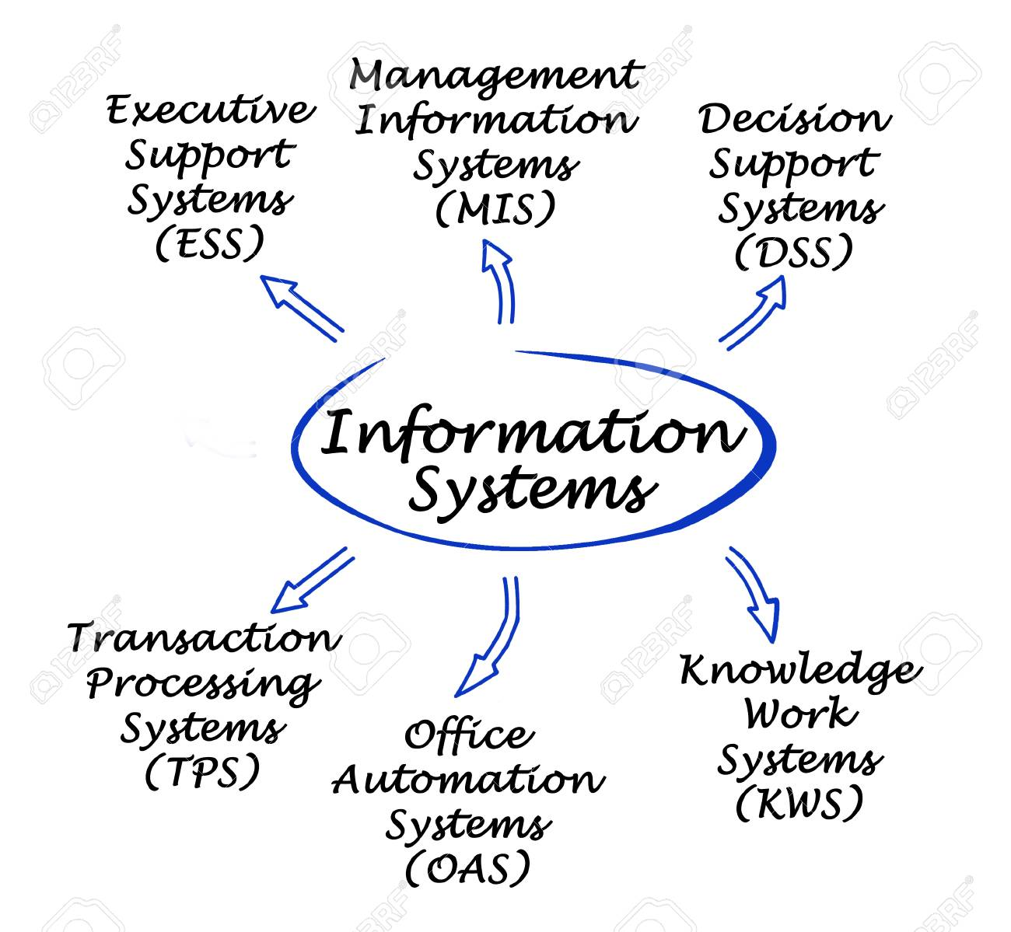
Architecture of Information System

Slide 16
Types of information System
1.Transaction Processing Systems (Line Workers)
2.Management Information Systems (Middle
managers)
3.Decision Support Systems (Senior Mangers)
4. Executive Support System (Executives)

Slide 17
Role of Information System In Business Today
Operational Excellence
New product, Services, and Business Model
Customer and Supplier Intimacy
Improved Decision Making
Competitive Advantage
Survival

Slide 18
Role of IT in Organization:
Information technology (IT) has become a vital and integral part of every business plan. From multi-national corporations who maintain mainframe systems and databases to small businesses that own a single computer, IT plays a role.
The reasons for the present use of computer technology in business can best be determined by looking at how it is being used across the business world.

Slide 19
Communication Between Employees ,Suppliers and Customers
Inventory Management Systems
Data Management Systems
Management Information Systems
Customer Relationship Management

Slide 20
Communication Between Employees, Suppliers and Customers
For many companies, email is the principal means of communication between employees, suppliers and customers.
Email was one of the early drivers of the Internet, providing a simple and inexpensive means to communicate.
Over the years, a number of other communications tools have also evolved, allowing staff to communicate using live chat systems, online meeting tools and video-conferencing systems.
Voice over internet protocol (VOIP) telephones and smart-phones offer even more high-tech ways for employees to communicate.

Slide 21
Managing information Technology in Organization
Project Leader:
Make sure to have an expert on your staff
Set Goals:
The goal of an organization need to be integrated with
an IT.
Read the manuals
Need to be familiar with the manual provided by an expert.
Test
Calibrate to your specifications
Summarize the manuals
Train Employees to operate the equipment
Learn from the success/failure of others

Slide 22
Steps to manage Technology Change
Take the opportunity to review business process first
Keep end users in the loop
Test and validate the system thoroughly
Role the solution out incrementally if needed.

Slide 23
End of Unit 1

Slide 24
Assignment 1 (Submission Deadline Jan 2,2023)
Is Khalti an e-commerce application ? Justify
Explain the role of IT in Human resource recruitment.
What are the things to be considered while managing IT in an organization ?
Do you think that IT is a must in an organization? Explain with examples.
Explain the components of an Information system.

